Slide 1
A pathway to policy commitment for sustainability of a key population-led health services model in Thailand
Dr. Preecha Prempree
Deputy Director-General, Department of Disease Control
Ministry of Public Health, Thailand

Slide 2
Background:
The Thailand Ministry of Public Health (MoPH) urged the country to utilize efficient and innovation approaches to end AIDS by 2030.
The key population-led health services (KPLHS) model has been proven to be efficient, safe, and feasible in;
Enhancing uptake of and retention in HIV testing;
Dispensing antiretroviral treatment for PLHIV who are clinically stable; and
Promoting and providing Pre-Exposure Prophylaxis (PrEP) services among key populations (KPs) including men who have sex with men, transgender women, and male and transgender sex workers in Thailand.

Slide 3
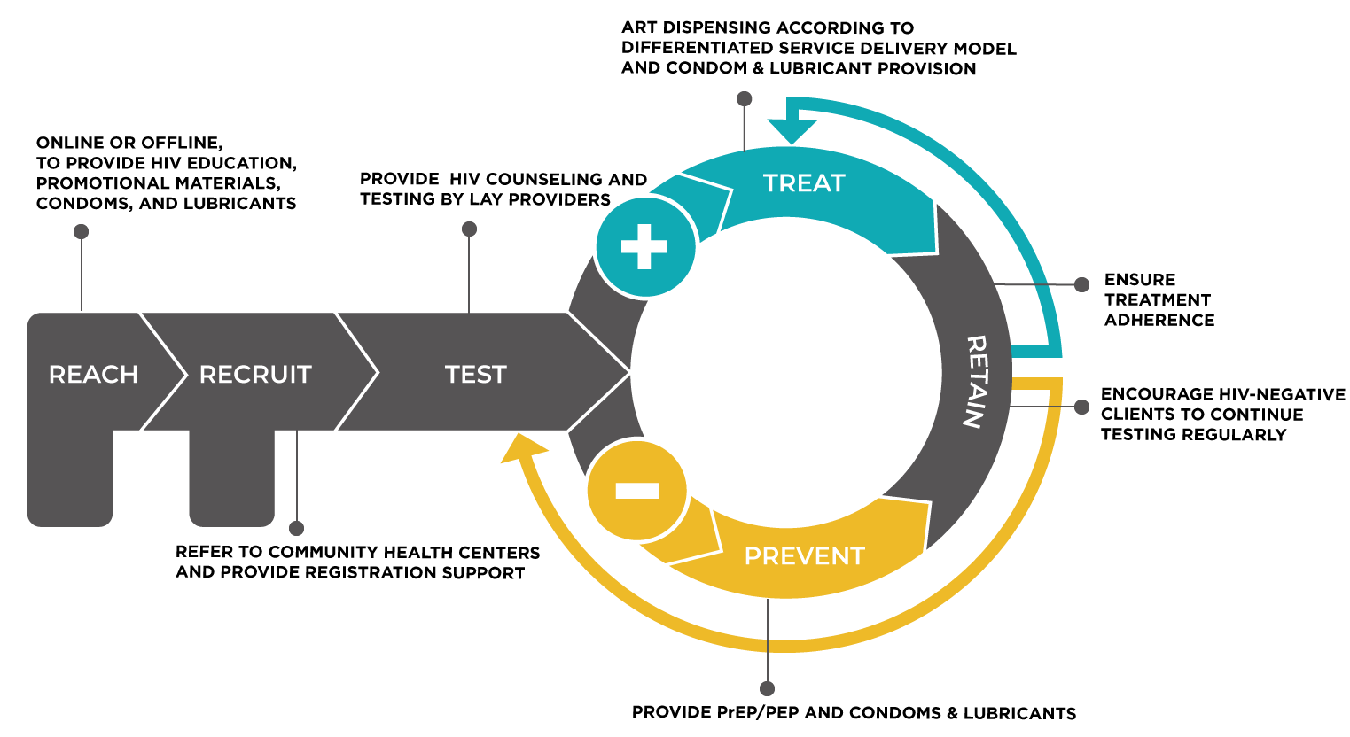
Key Population-Led Health Services model

Slide 4
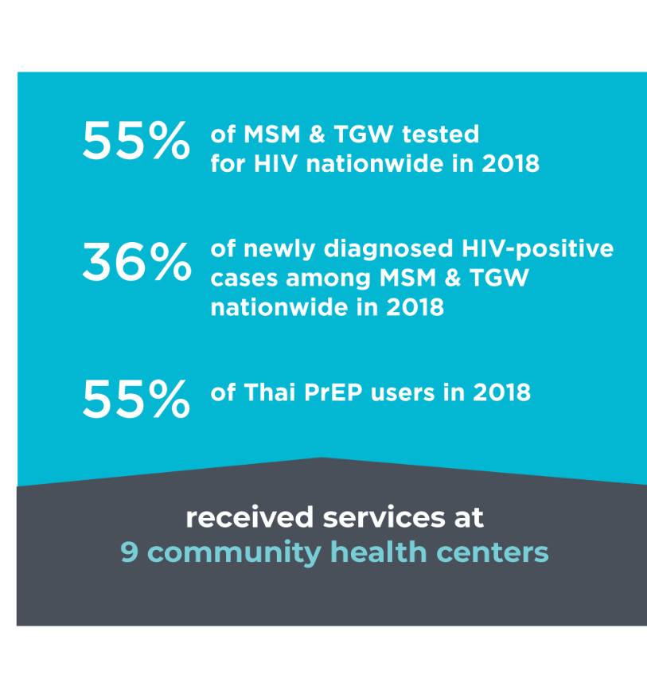
Background:
In 2018, KP lay providers provided services accounting for:
55% of MSM &TGW tested for HIV nationwide;
36% of newly diagnosed HIV-positive cases; and
more than 50 % of Thai PrEP users.
Therefore; for KPLHS scale-up and sustainability, policy commitment must be achieved to ensure legalization and domestic financing mechanisms.

Slide 5
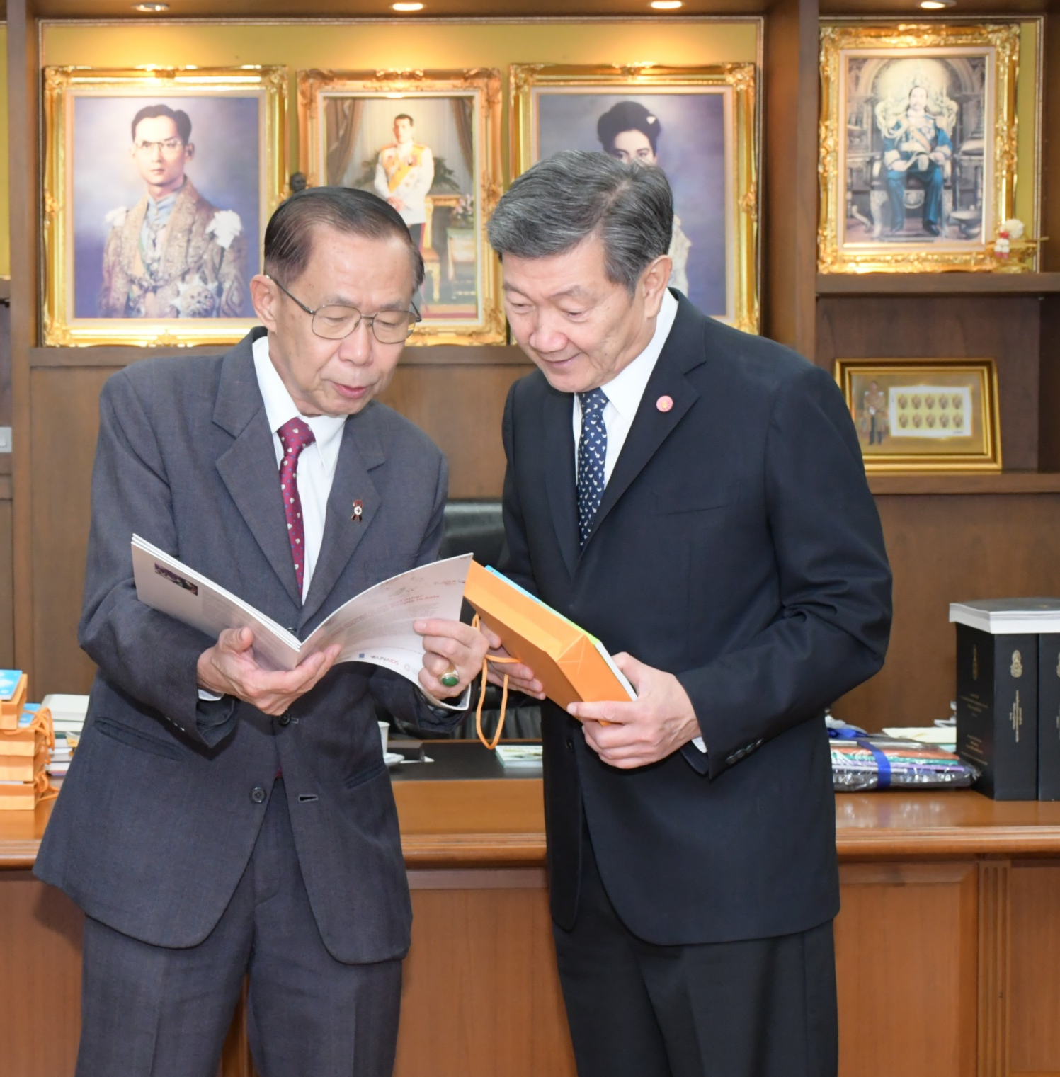
Method:
A series of high-level policy and advocacy dialogues were held with MoPH stakeholders during 2017 and 2018 in order to:
Legalize HIV service delivery by KP lay providers;
Enhance capacity of KP lay providers through a certification and accreditation system; and
Sustain the KPLHS model through domestic health financing mechanisms

Slide 6
Legalizing KP lay providers who deliver HIV services
With strong leadership of the minister of public health, three ministerial regulations were signed on June 6th, 2019 and announced in the government gazette on June 18th, 2019.
These regulations legalize the delivery of HIV services by KP lay providers under the supervision of health professional councils:
Finger prick blood collection and HIV testing;
Sample collection for STI rapid testing;
PrEP and ARV dispensing; and
STI screening and treatment.

Slide 7
Enhancing capacity of KP lay providers through a certification and accreditation system
The USAID Community Partnership Project closely collaborated with the Bureau of AIDS, TB and STIs to establish a training and certification platform and facilitated regulatory reform to allow KP lay providers to deliver high-quality HIV and sexually transmitted infection services.
By June 30th, 2019, 126 KP lay providers from 9 community based-organizations (CBOs) received training; HIV basic knowledge, counseling and testing, PrEP and ARV dispensing;
70% of those who passed the training course are serving clients as part of a practicum process.
A final certification assessment for those who complete serving clients as part of a practicum process will be conducted by The USAID Community Partnership Project.

Slide 8
Sustaining the KPLHS model through domestic health financing mechanisms
Previously, CBOs could not receive direct funding from the National Health Security Office (NHSO) because they could not legally provide services and there were questions on service quality.
The Thai Red Cross AIDS Research Centre and CBOs, supported by LINKAGES Thailand and USAID Community Partnership Project, provided feasibility, impact, and health economic data on HIV services provided by CBOs to assist policy decisions.
Under the leadership of minister of public health, NHSO has identified five critical steps for CBOs to register as a HIV testing service center under Universal Health Coverage scheme.
This implies that a registered CBO would receive direct funding from the NHSO, leading to sustainability of the KPLHS model.

Slide 9
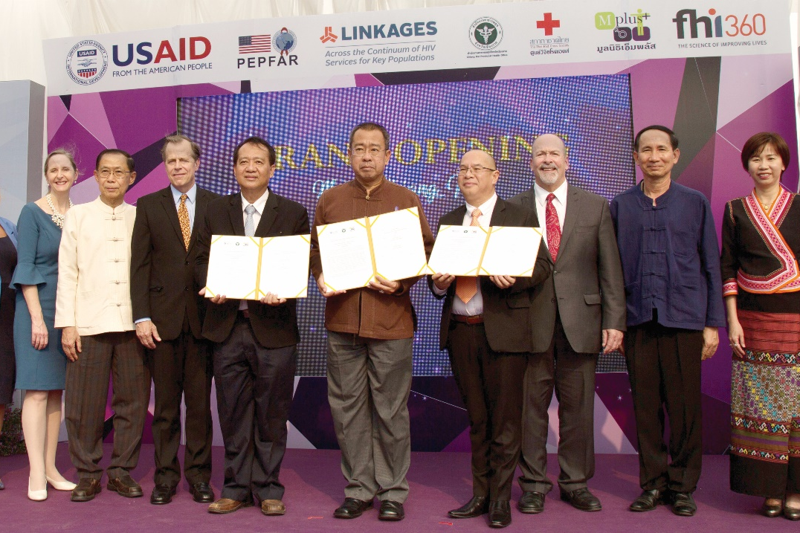
Five requirement steps for CBOs to register as a node under NHSO scheme
Notes:
Registered as medical technologist (MT) clinic by provincial health office
Accredited on laboratory accreditation by MT association of Thailand
Partnering with local hospital as a referral site for MT clinic through official document
Assessed laboratory on quality, capacity, and management aspects by NHSO
Signed a contract with central NHSO as a node for HIV testing services to received direct funding

Slide 10
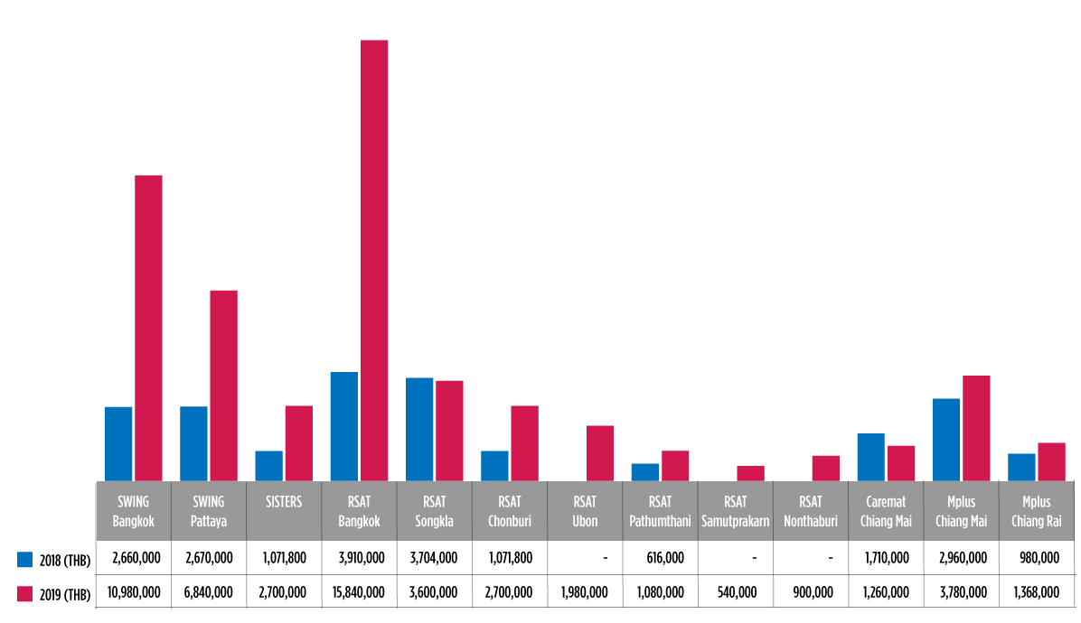
Promising practices: Thailand
Public sector expenditures for KP HIV prevention have increased significantly since 2016
Improved systems and legal frameworks for enhancing contributions of KP community-based organizations
Accreditation and reimbursement processes and standards for CBOs and private clinics
Management of CBO contracts through provincial sub-grants
Inclusion of PrEP in Universal Coverage
Challenges: determining appropriate and acceptable costs for services for sustainability
NHSO funding trends from 2018 to 2019
305%
313%
156%
-3%
-28%
152%
152%
75%
-26%
40%

Slide 11
Conclusion:
Concerted efforts among key policy stakeholders, academia, and CBOs, together with strong leadership by the MoPH, helped advance regulatory reform to legalize provision of HIV services by KP lay providers and facilitated piloting of transition from international aid to domestic funding for sustainability of the KPLHS model.
Strong leadership of key MoPH policy makers to integrate the KPLHS model into the national health system was a game changer for the HIV/AIDs program in Thailand.

Slide 12
Acknowledgments

